Slide 1

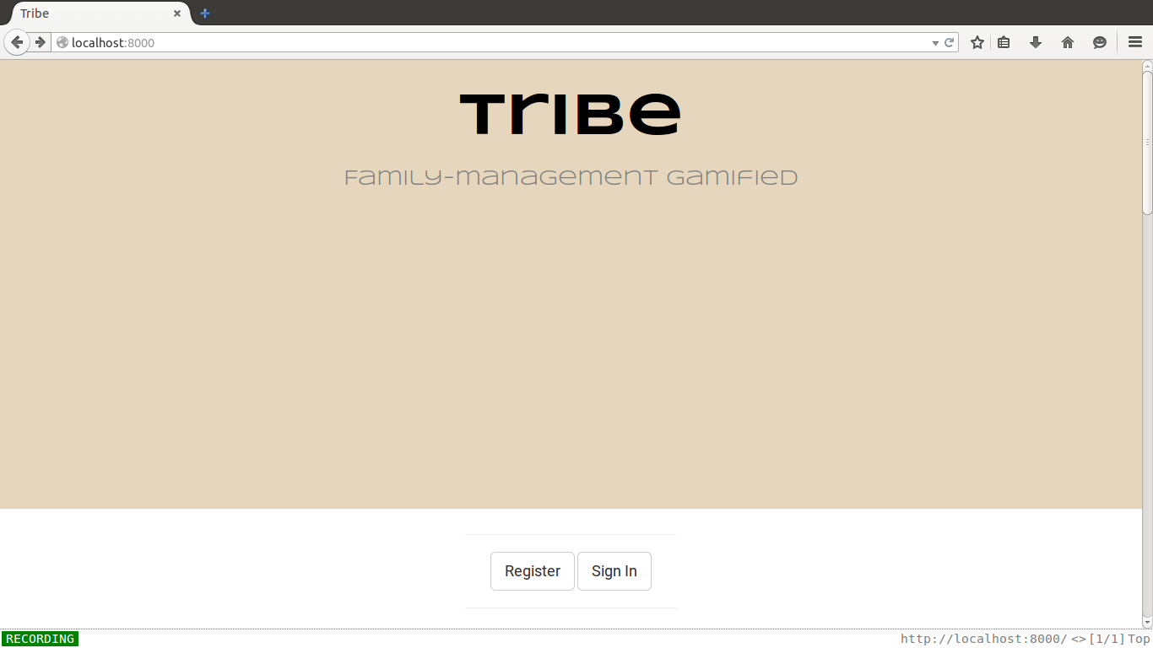
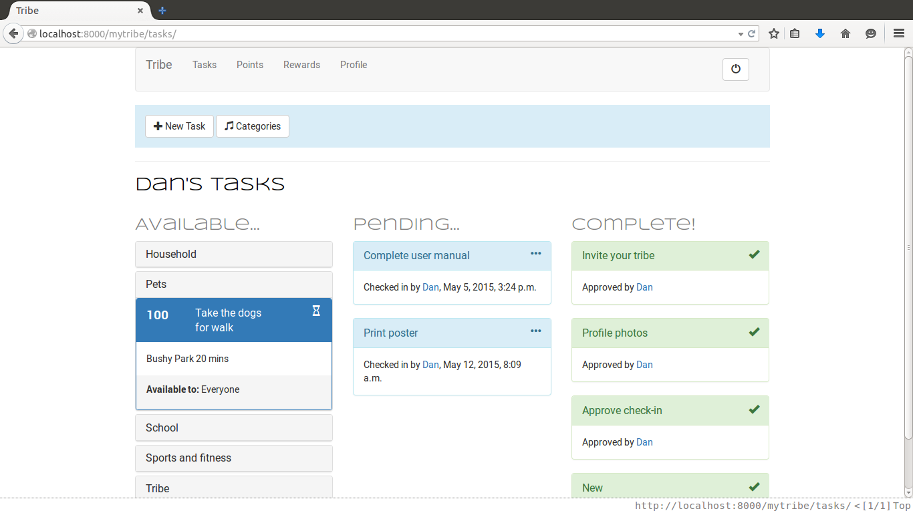
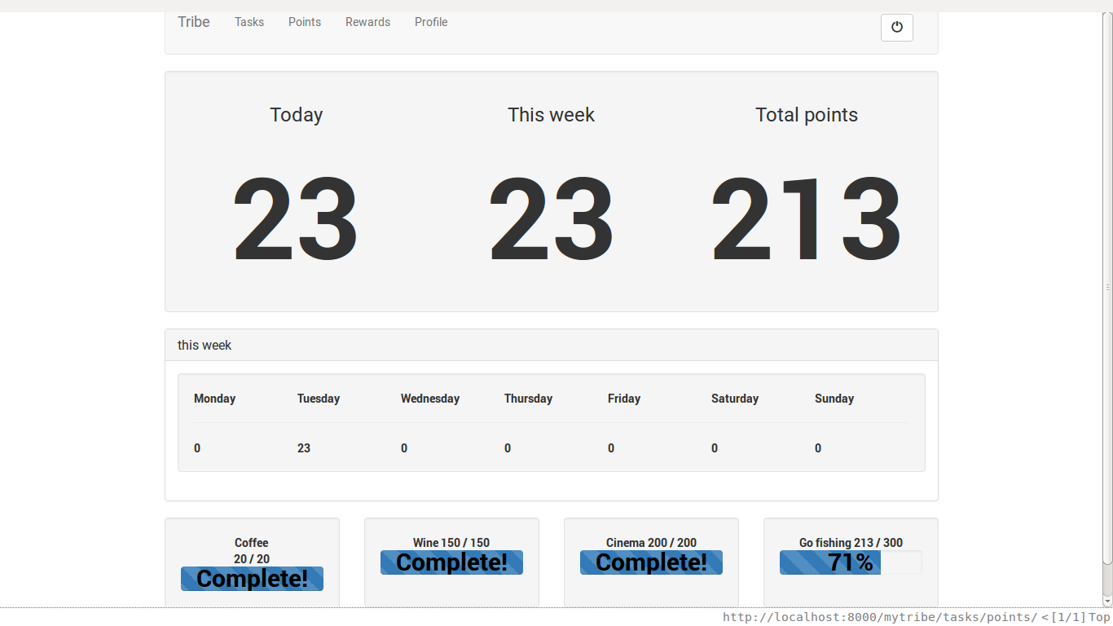
Tribe
Daniel Feely BSc Computing, Evening
Tasks and points system for families.
Get organised with gamification.
Abstract:
Motivation
Create motivation for family members to work together on completing day-to-day tasks.
Schoolwork
Remind and encourage kids to complete homework.
Accountability
Allow parents to check that kids' homework has been done. Make sure everybody knows the dog has already been walked and fed.
Family Interaction
Encourage the family to spend time together and co-operate.
Fun
Give a sense of satisfaction and joint achievement and add a fun element to day-to-day tasks.
Project Goals
Python
Django
SQLite
HTML5
CSS
Javascript
Bootstrap
Github
Taiga.io
Travis-CI
Technologies used
Notes:
<number>

